Slide 1

Library Management System
LMS
End-to-End Database Design, Dictionary & Transaction Pathways
Presented by:
1.Mahitab Hesham , ID: 2402242905
2.Mariam Osama Ahmed, ID:2402245940
3. Mina Emad Shehata, ID: 2402248742
4. Ziad Sabry Khalil, ID: 2403247475
5. Abdelrahman Amin Gomaa, ID: 2402247607
6. Mostafa Salah Aldeen Sabry, ID: 2402241166

Slide 2

Agenda
Project scope & objectives
Data-dictionary (entities, attributes, domains)
Core SQL query catalogue
ER model & relational mapping
Business rules & integrity constraints
Transaction pathways (step-by-step data flow)

Slide 3
Project scope & objectives
Centralized catalogue for books, users, staff & author
Role-based access: Student, Faculty, External, Librarian, Library Technician, Library Manager, Library Assistant
100 % web-based: PHP back-end + responsive Arabic/English UI
Automatic age & borrowing-limit validation
Real-time inventory & overdue tracking

Slide 4

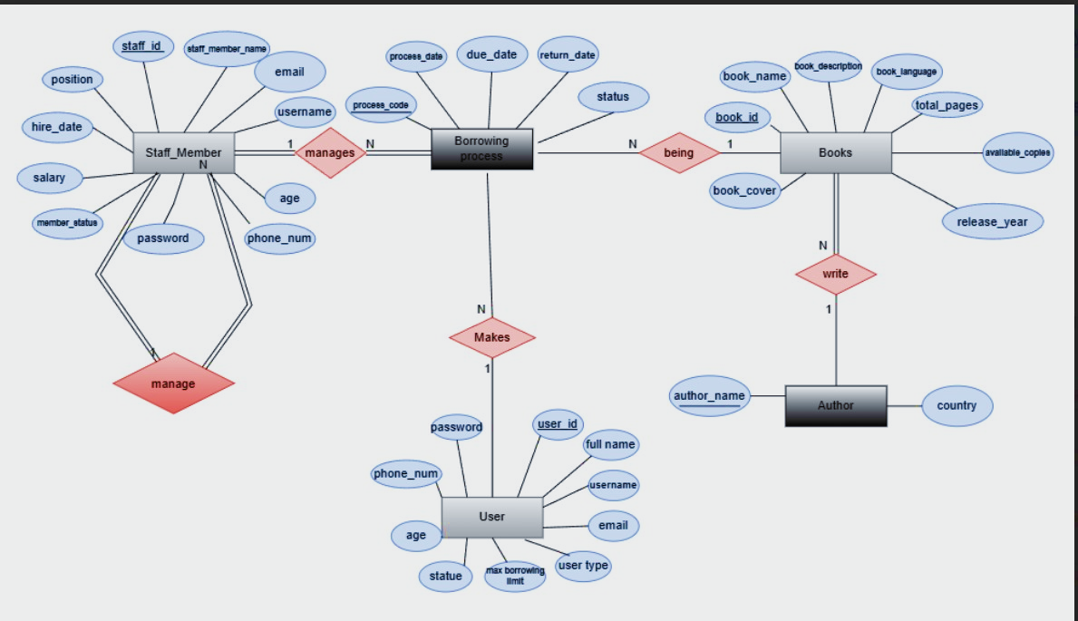
High-Level ER Diagram

Slide 5
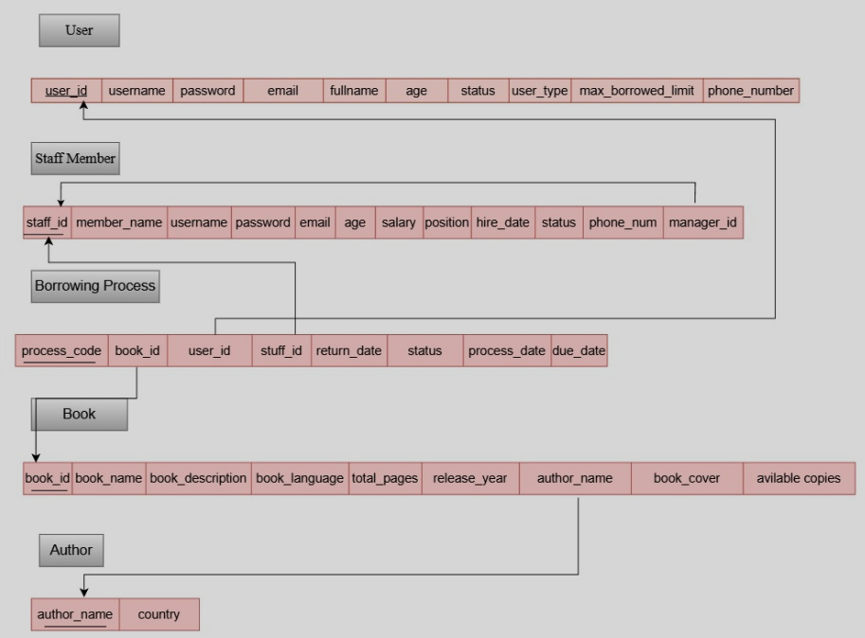
Mapping The LMS Schema

Slide 6
Data Dictionary Conventions
Keys
Data
types
Character set
PK = Primary Key, FK = Foreign Key, U = Unique
INT(11), VARCHAR(100), DATE, YEAR, BLOB (cover)
utf8mb4 (Arabic + English)
Engine
InnoDB → referential integrity + transactions

Slide 7
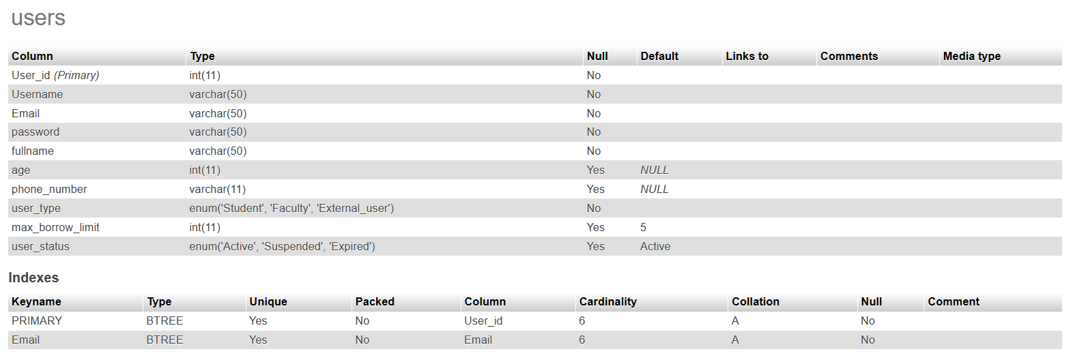
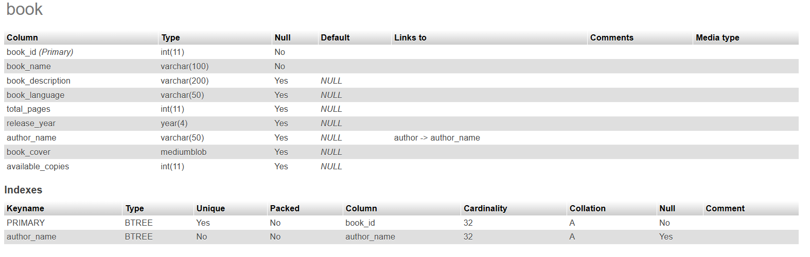
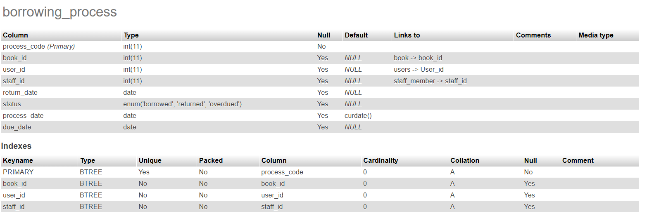
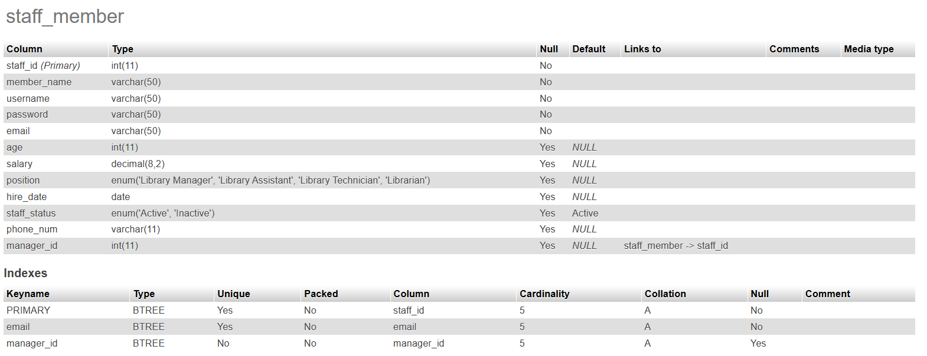
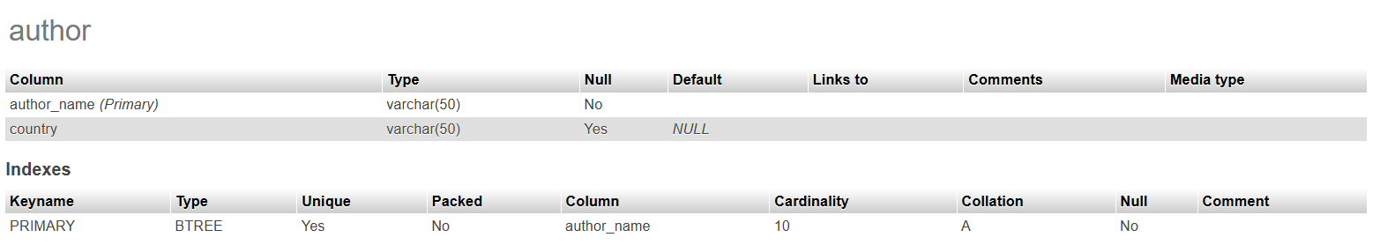
Entity Dictionary

Slide 8
Business Rules Summary
Age gates
Inventory
Borrowing limits
User ≥ 15, Staff ≥ 25
available_copies ≤ total_copies, never negative
Student 3, Faculty 10, External 5
Temporal
return_date ≥ process_date; due_date = process_date + 14
Cascade
deletes blocked when active loans exist

Slide 9
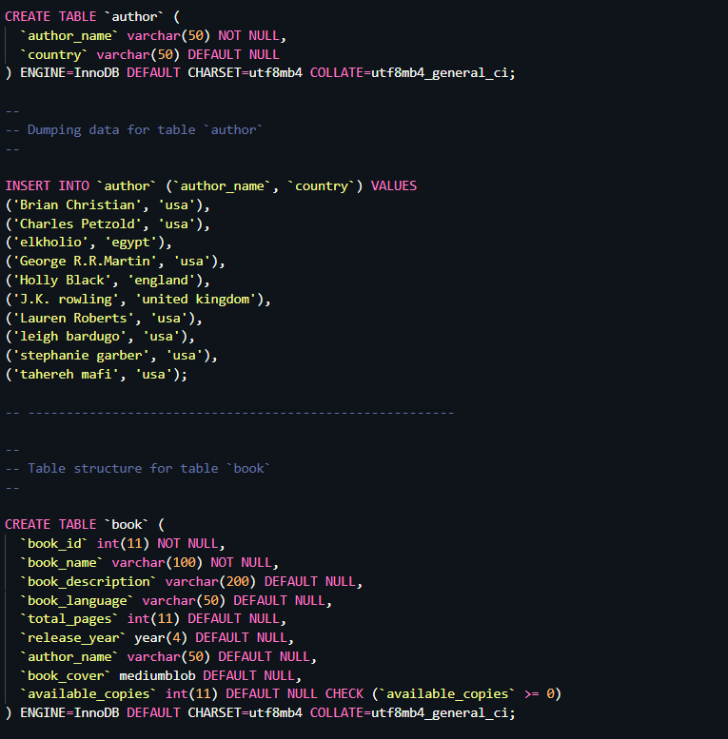
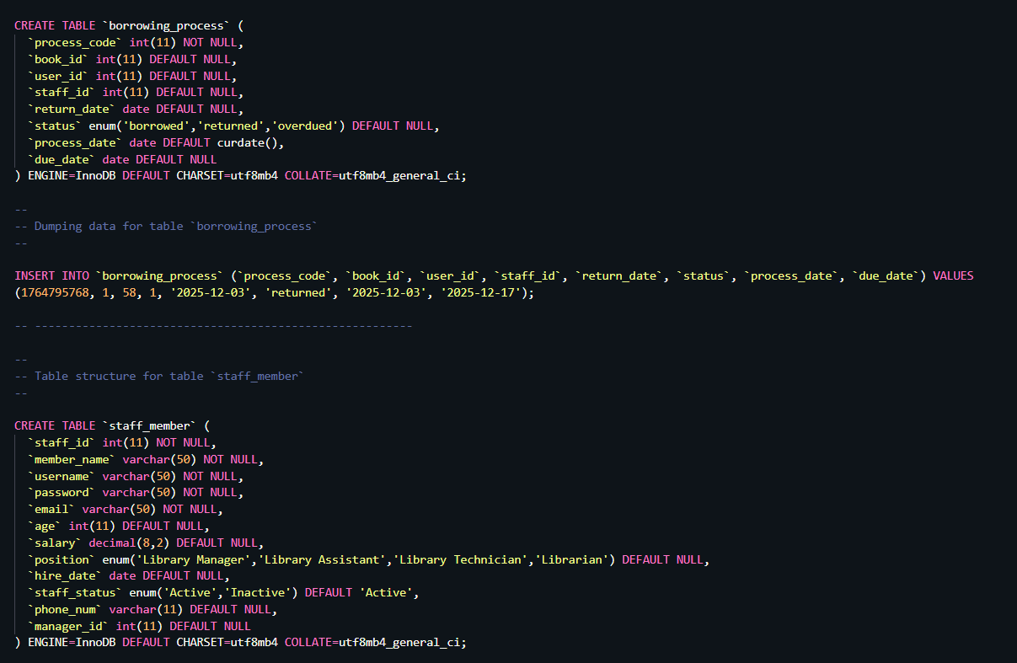
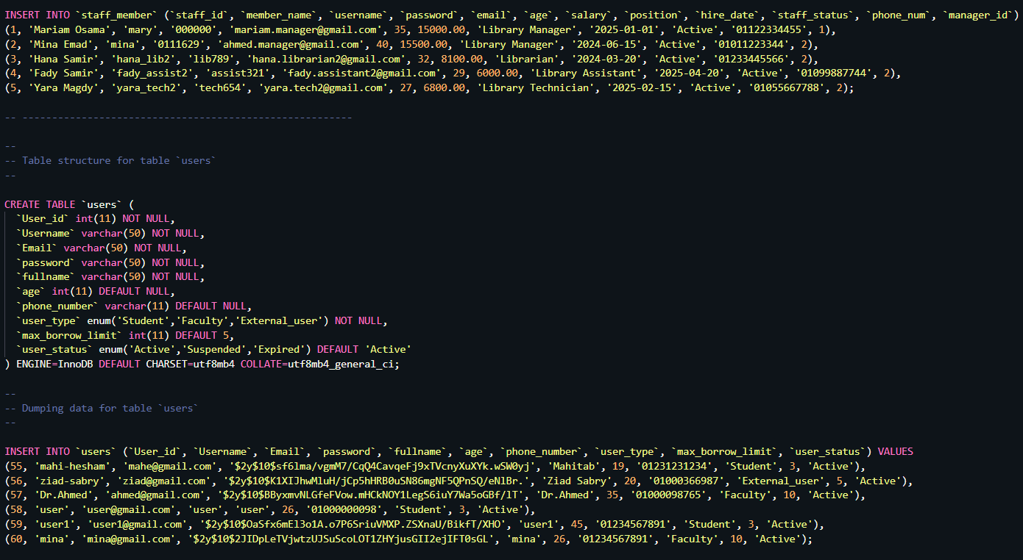
SQL DDL

Slide 10

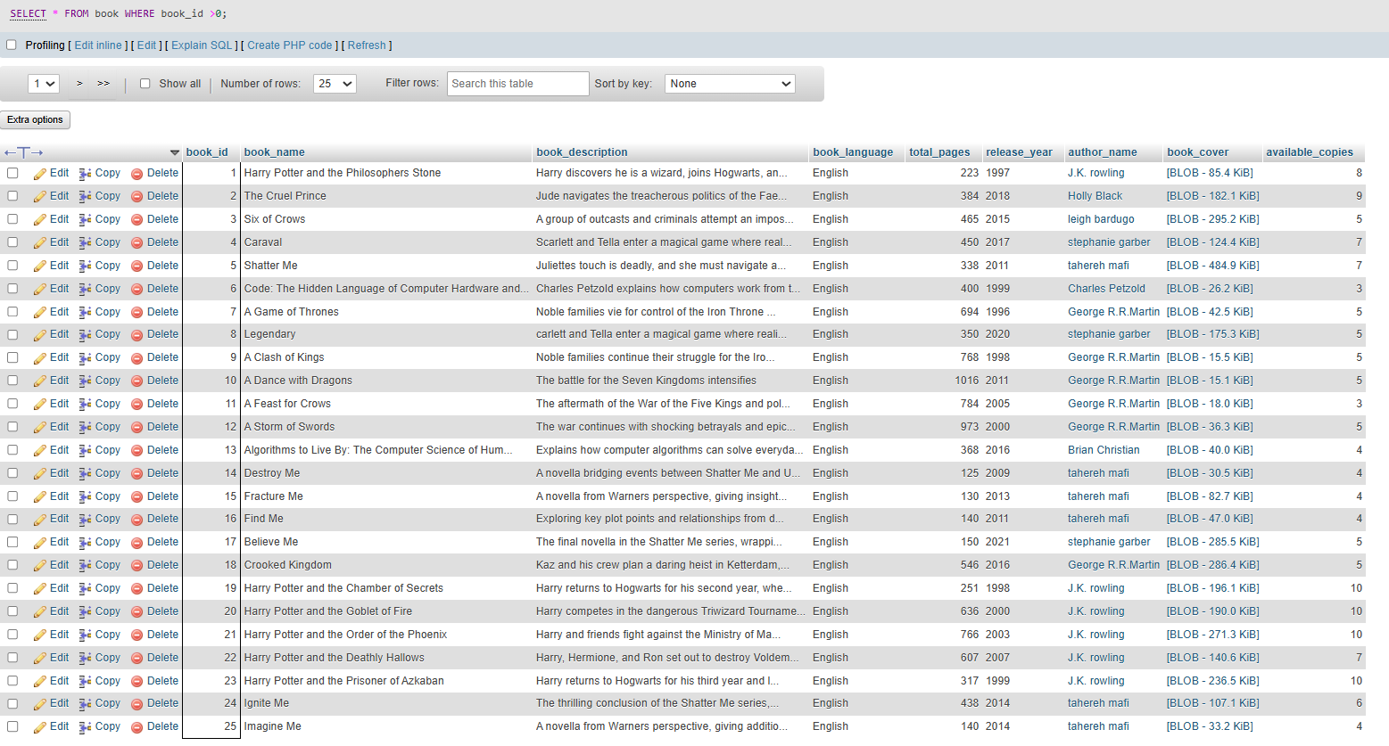
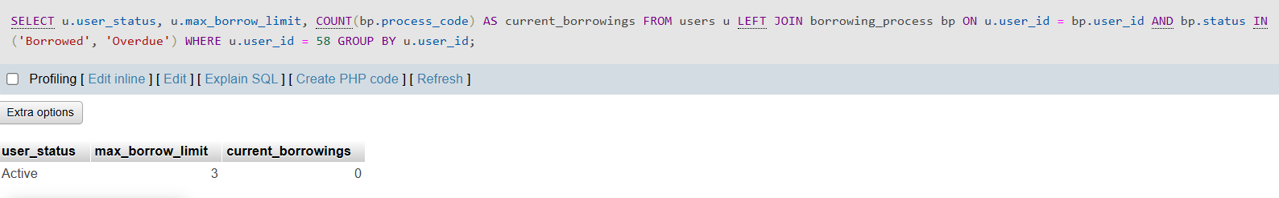
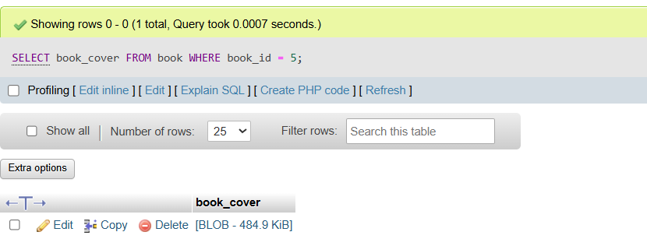
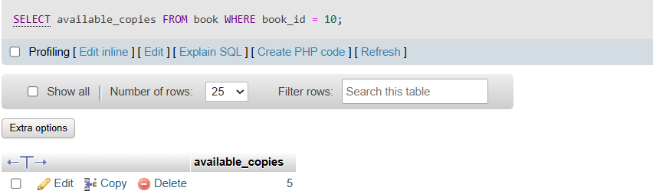
SQL DML

Slide 11
Transaction Pathway for Borrowing Book
Client sends {user_id, book_id, staff_id}
Validate user
(status, limit)
Validate book (available_copies > 0)
INSERT borrowing_process (status=‘Borrowed’, due=+14 d)
UPDATE book SET available_copies = available_copies – 1
COMMIT → reply {success, process_code, due_date}
Rollback on any exception → user sees one concise error

Slide 12
Transaction Pathway for Adding New Book
POST {action:‘books_add’, book_name, author_name, publishing_year, available_copies, …} → library.php
Staff (position=Library manager) fills “Add Book” form
Front-end validates (required fields, numeric copies, URL cover)
Back-end checks permission (requireStaff)
If new author → INSERT INTO author (author_name) ON DUPLICATE KEY UPDATE
INSERT INTO book (…) VALUES (…)
Rollback on any PDOException → reply {success: false, message}
Reply {success: true, book_id, message} → toast “Book added”

Slide 13
Transaction Pathway for Deleting Book
Staff enters book_id, confirms deletion
POST {action:‘books_delete’, book_id} → library.php
require Staff check
SELECT COUNT(*) FROM borrowing_process WHERE book_id=? AND status=‘Borrowed’
If count > 0 → reject “Cannot delete – active borrowing process”
ELSE DELETE FROM book WHERE book_id=?
Rollback on any exception → user sees one concise error
Reply {success:true} → UI removes card, reloads catalogue

Slide 14
Transaction Pathway for Adding New User
Public form (fullname, username, email, phone, age, password, user_type)
JS validates (age ≥ 15, password ≥ 6, email regex)
POST {action:‘register_user’, …} → user_staff.php
INSERT INTO users (…, password=hashPassword(..), age=calculated)
On duplicate username/email → reply 23000 error → “Already exists”
Reply {success:true, user_id} → modal closes, toast “Registration successful”
Rollback on any exception → user sees one concise error

Slide 15
Transaction Pathway for Deleting User
Staff (manager) clicks “Delete User”, confirms
POST {action:‘delete_user’, user_id} → user_staff.php
requireStaff check
SELECT user_id FROM users WHERE user_id=? FOR UPDATE)
DELETE FROM users CASCADE (borrowing_process )
COMMIT → reply {success:true} → row removed from user list
Rollback on any exception → user sees one concise error

Slide 16
Transaction Pathway for Adding Stuff Member
Manager-only form (staff_member_name, username, email, position, hire_date, salary, age, password)
JS + server age check (≥ 25)
POST {action:‘register_staff’, …} → user_staff.php
requireManager check
INSERT INTO staff_member (…, password=hashPassword(..), age=calculated)
On duplicate username/email → reply 23000 error
Rollback on any exception → user sees one concise error
Reply {success:true, staff_id} → table refreshed, toast added

Slide 17
Transaction Pathway for Deleting Staff Member
Manager clicks “Delete Staff”, confirms
POST {action:‘delete_staff’, staff_id} → user_staff.php
requireManager check
SELECT staff_id FROM staff_member WHERE staff_id=? FOR UPDATE
DELETE FROM staff_member CASCADE (loans managed by FK)
COMMIT → reply {success:true} → staff list reloaded
Rollback on any exception → user sees one concise error

Slide 18
Transaction Pathway for Searching Borrowing Processes
Staff/User enters user_id or process_code
SELECT bp.process_code, b.book_name, bp.due_date, bp.status, DATEDIFF(CURDATE(),bp.due_date) AS days_overdue FROM borrowing_process bp JOIN book b ON bp.book_id=b.book_id WHERE bp.user_id=? ORDER BY bp.process_date DESC
POST {action:‘borrow_user_list’, user_id} → library.php
Return JSON array → front-end renders list cards
If empty → show “No borrowing history” placeholder

Slide 19
Transaction Pathway for Login as User
User tab → enter username, password
POST {action:‘user_login’, username, password} → user_staff.php
SELECT user_id, password, user_status FROM users WHERE username=?
verifyPassword(password, hash)
If fail → reply {success:false, message}
Else $_SESSION[‘user_id’] = id; reply {success:true, role:‘user’, username}
UI hides login modal, enables user-only panels, shows logout button

Slide 20
Transaction Pathway for Login as Staff / Manager
Staff tab → enter username, password
POST {action:‘staff_login’, username, password} → user_staff.php
SELECT staff_id, password, position, staff_status FROM staff_member WHERE username=?
verifyPassword(password, hash)
If fail → reply {success:false, message}
Else $_SESSION[‘staff_id’] = id; reply {success:true, (position ==‘Library Manager’)
UI reveals staff/manager panels, adds logout button

Slide 21
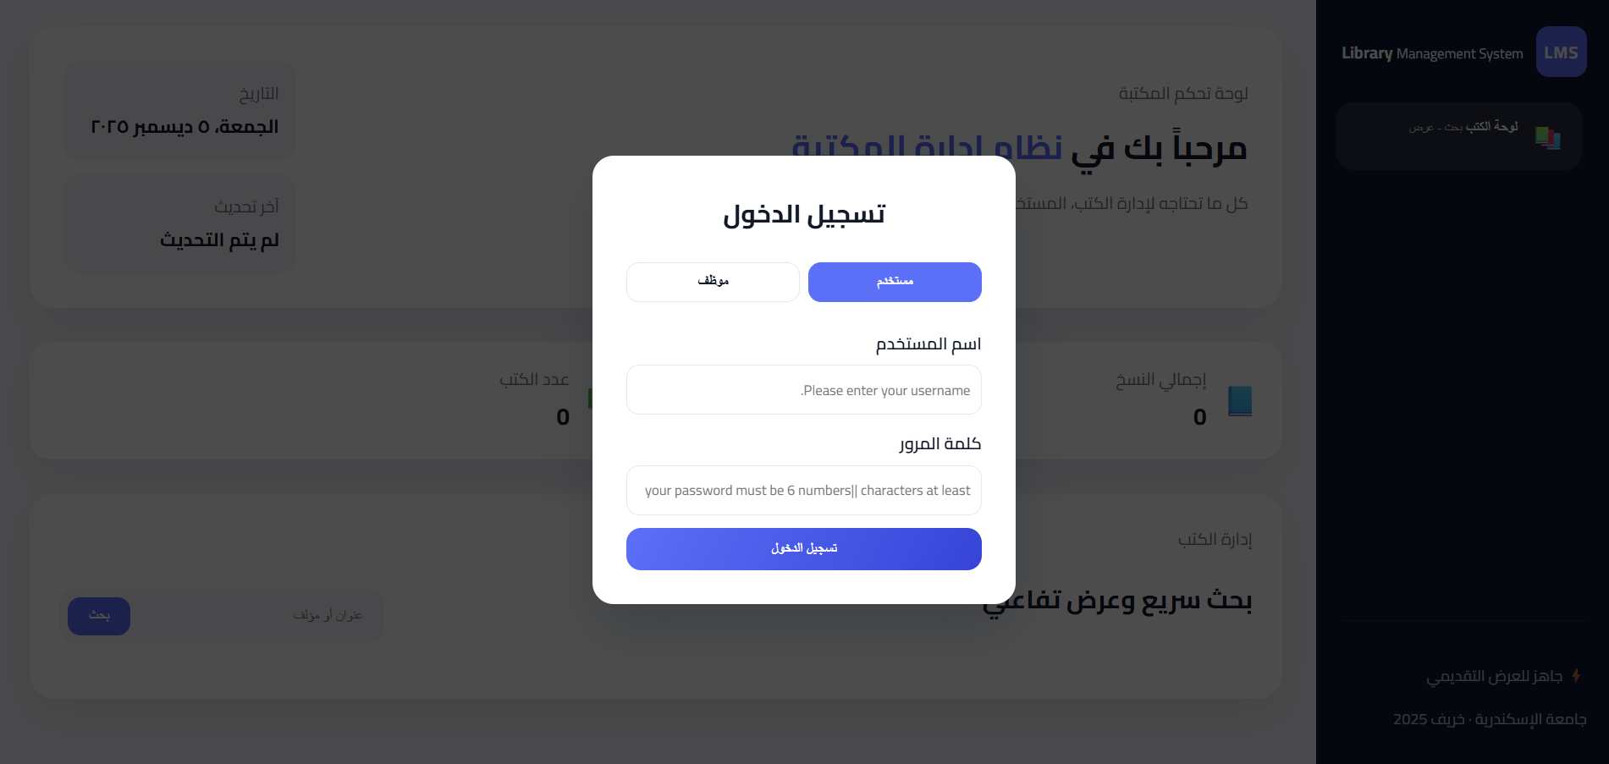
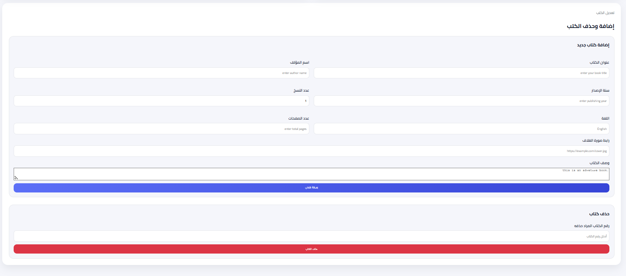
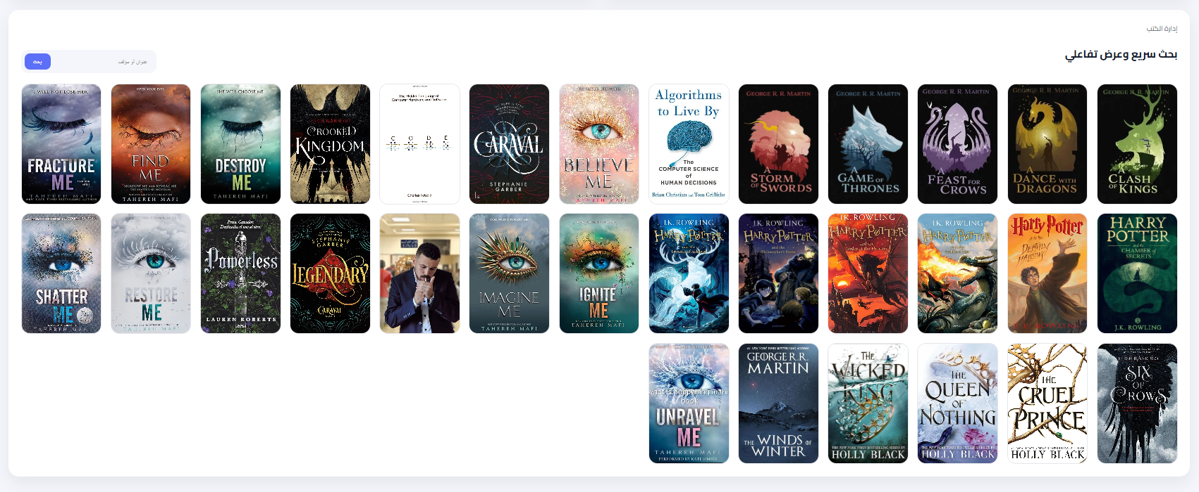
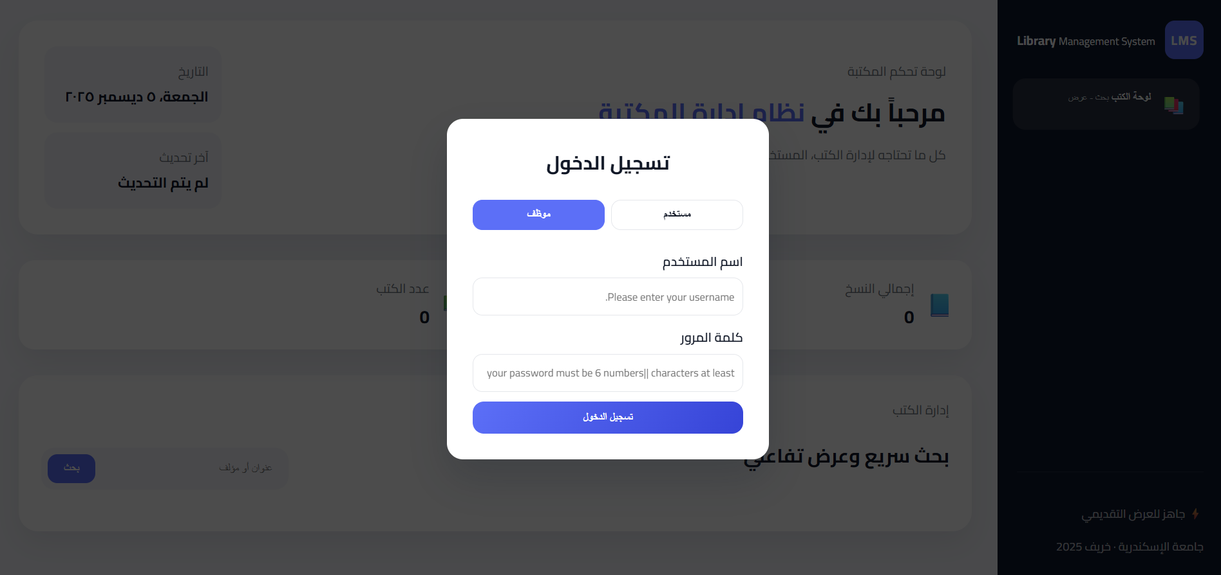
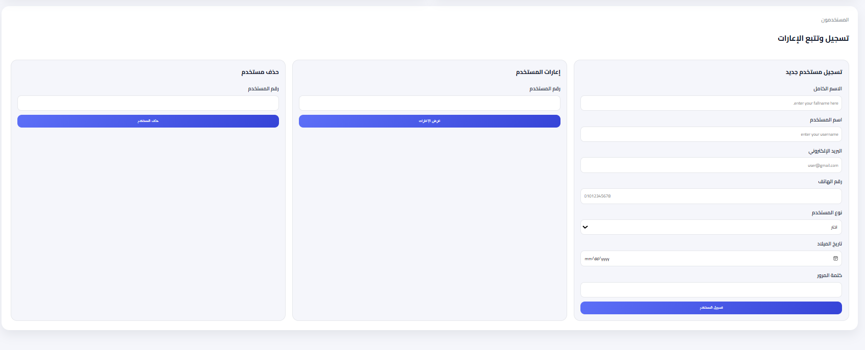
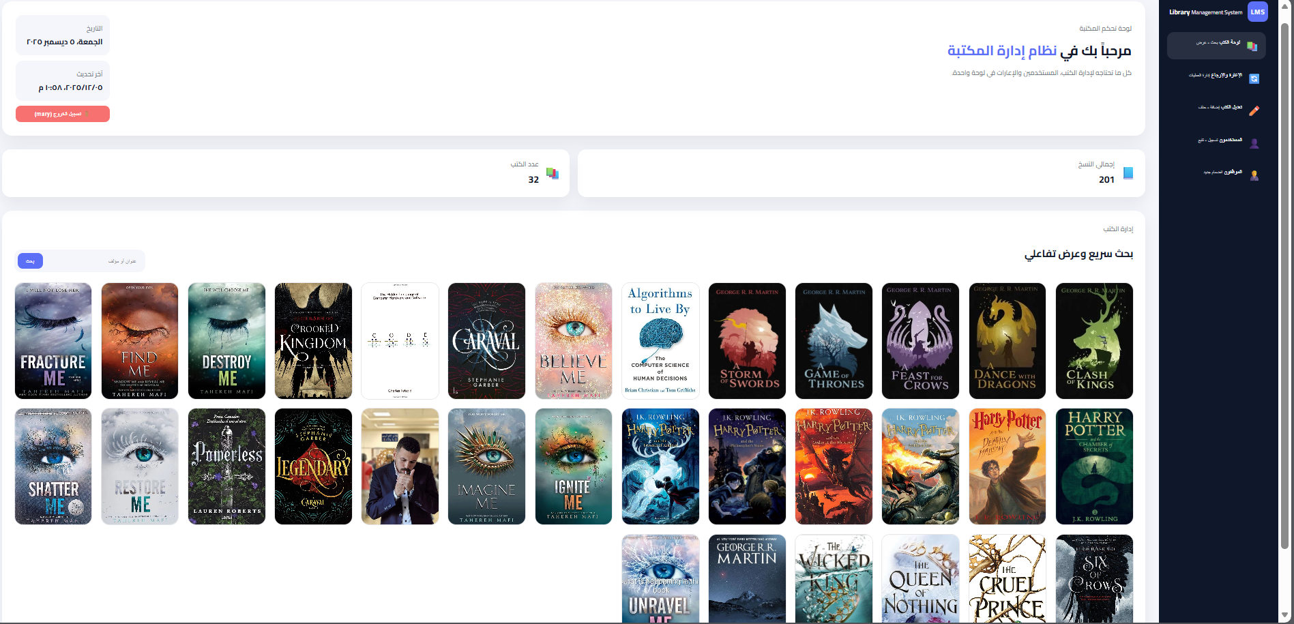
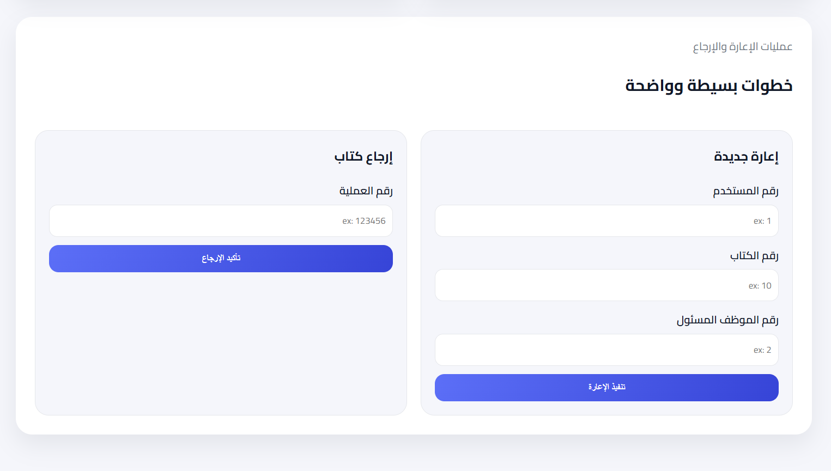
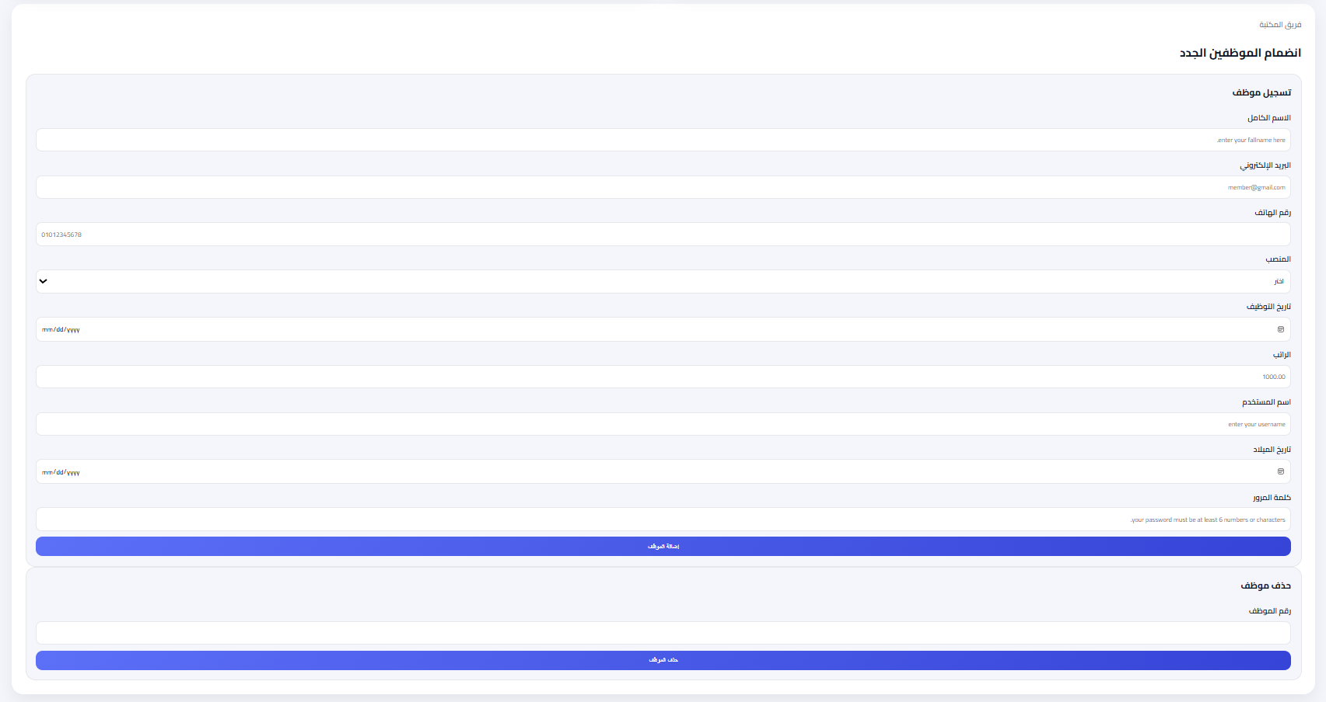
GUI For LMS

